Slide 1
Software-Defined Network
Compare Virtualization of Computing and Networking
Presenter: Jason, Tsung-Cheng, HOU
Advisor: Wanjiun Liao
Mar. 8th, 2012

Slide 2
Motivation
Now emerging:
SDN: Software-Defined Network
Generalized network virtualization
ONS: Open Networking Summit
A lot of sponsors and Nicira
ONF: Open Networking Foundation
Bearing OpenFlow standard and beyond
A New Net, Technology Review
Commercialized products for data centers and production network

Slide 3
Motivation
What’s the essence of virtualization?
In the context of cloud computing
Compare virtualization of:
Computing: already widely adopted
Networking: has just begun
What are the differences?
A glance at current researches around this main concept (SDN).
Any further research directions?

Slide 4
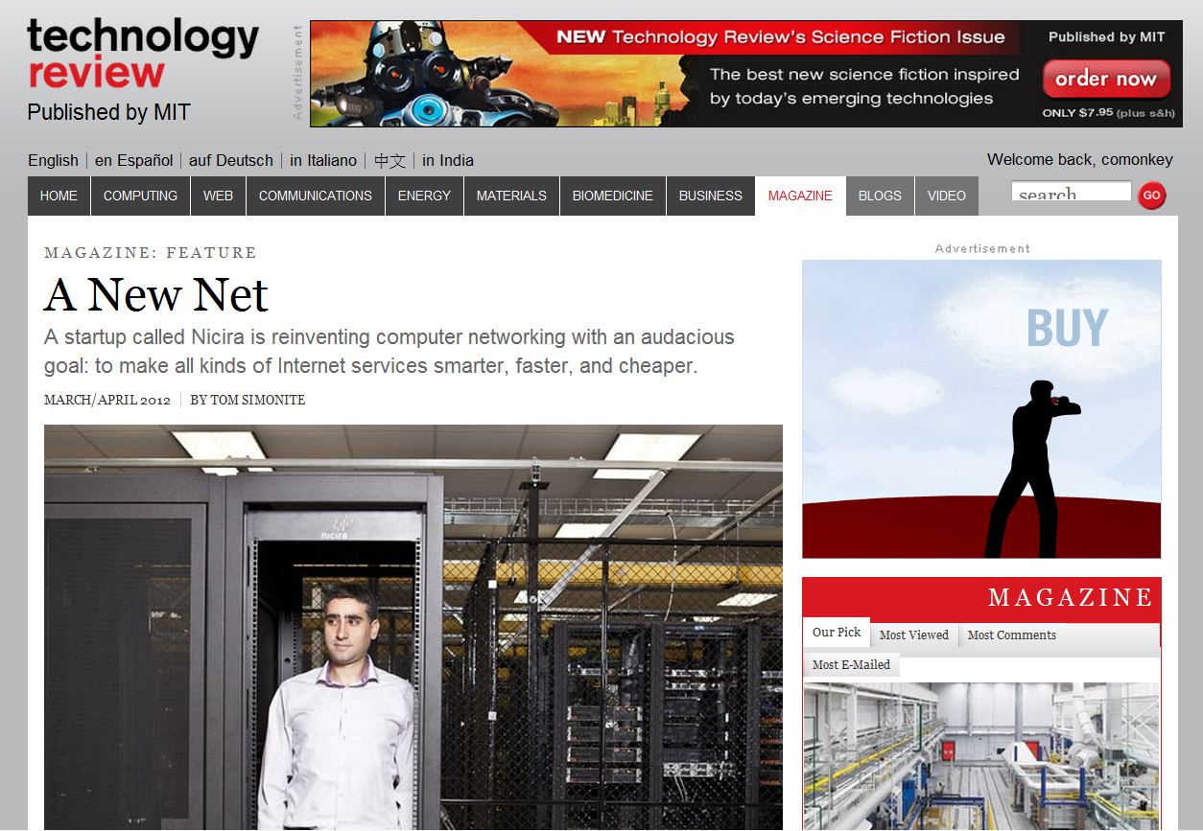

Slide 5
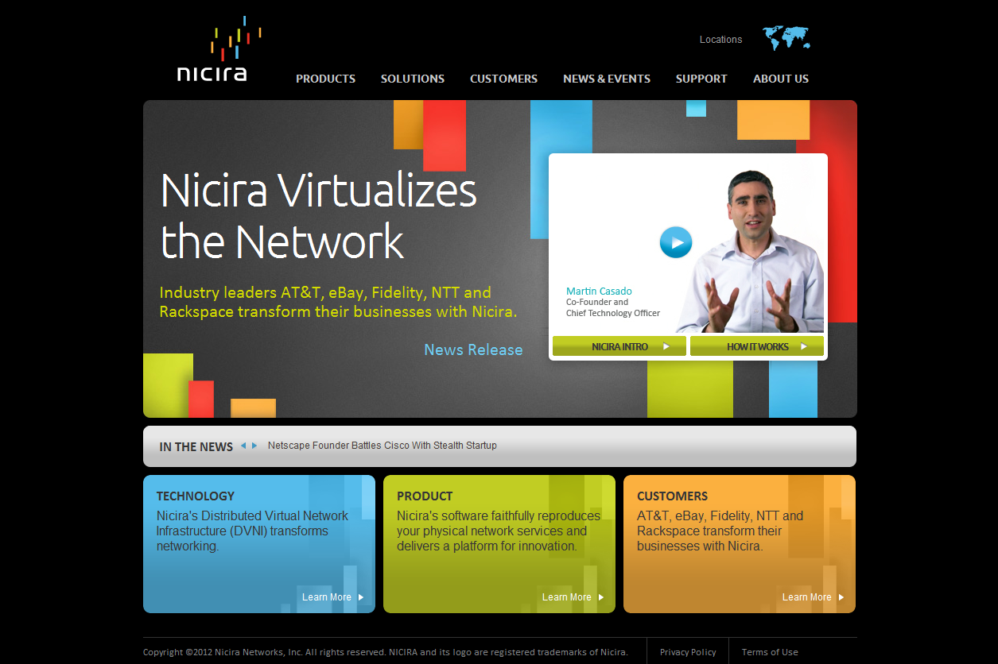

Slide 6
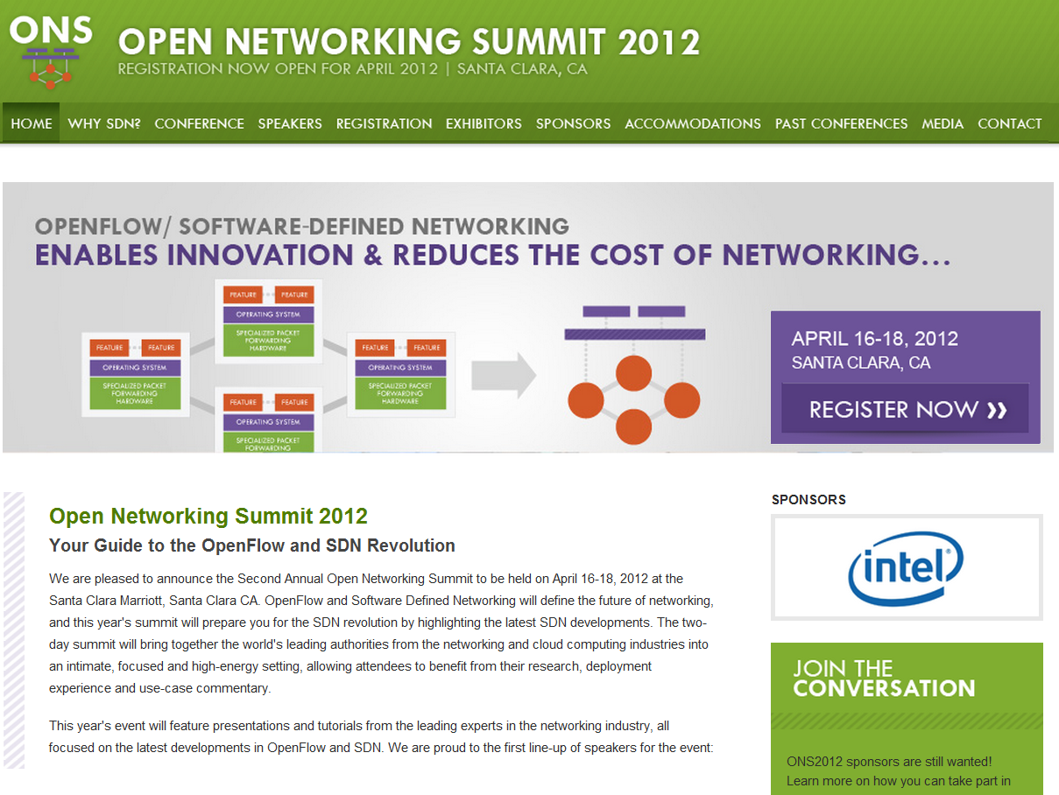

Slide 7
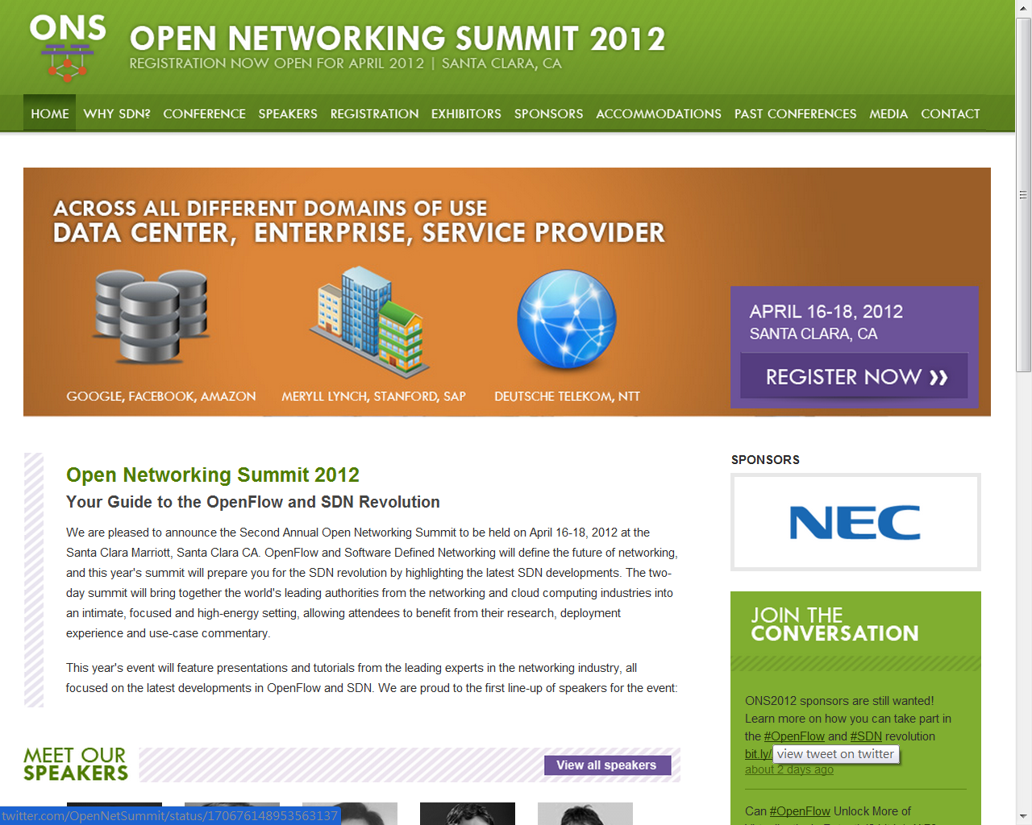
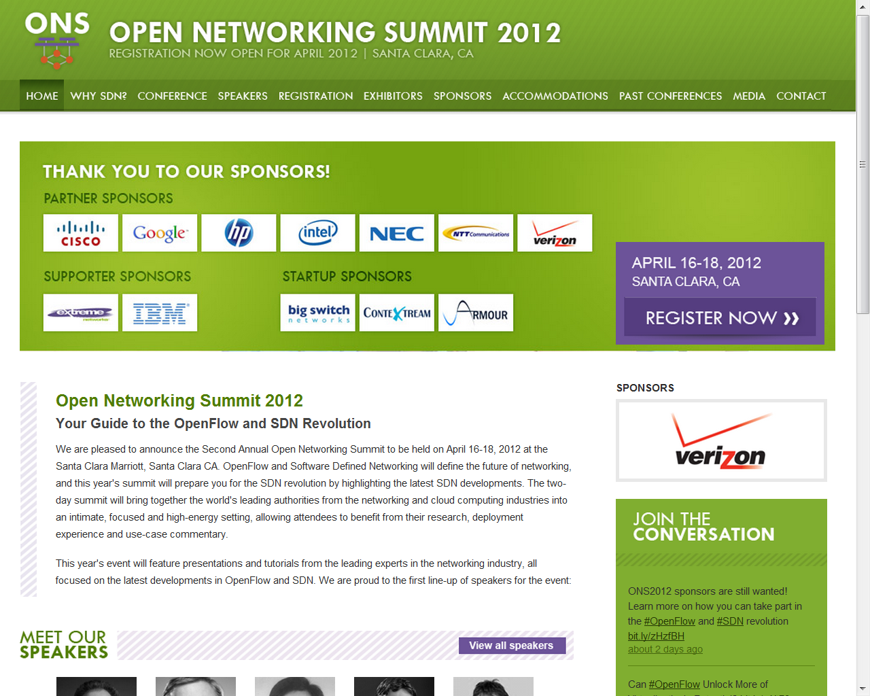

Slide 8
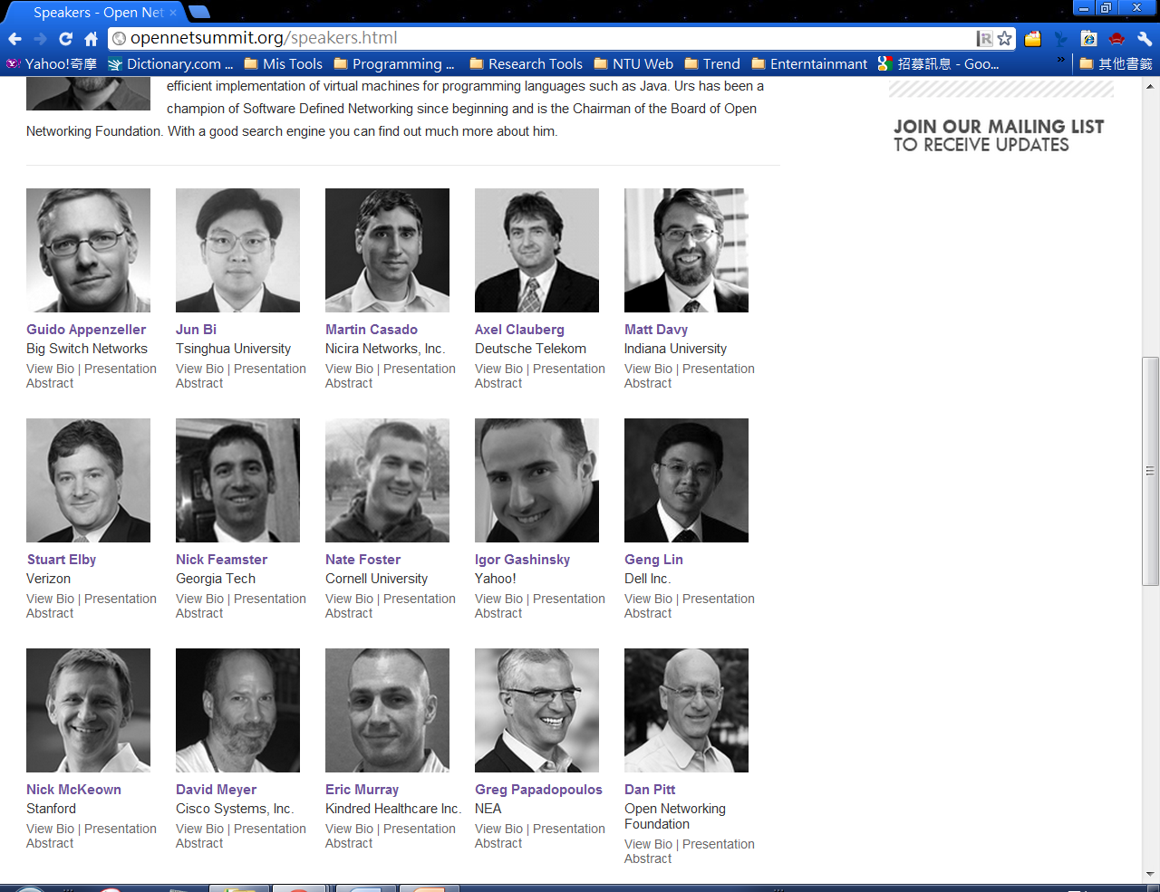
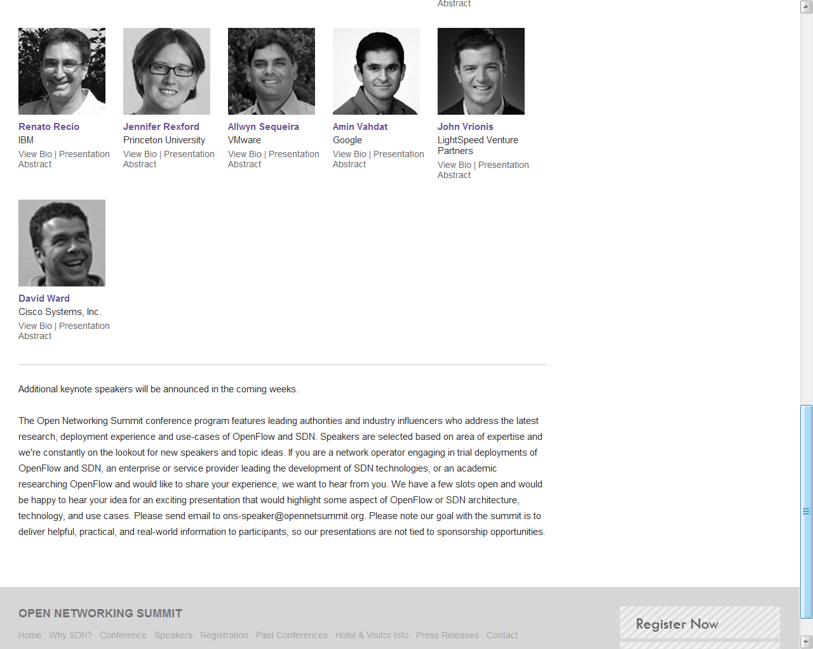

Slide 9
Agenda
The Concept of Virtualization
Virtualization of Computing
Virtualization of Networking
Software-Defined Network
Possible Directions

Slide 10
Agenda
The Concept of Virtualization
Virtualization of Computing
Virtualization of Networking
Software-Defined Network
Possible Directions

Slide 11
Concept of Virtualization
Decoupling HW/SW
Abstraction and layering
Using, demanding, but not owning or configuring
Resource pool: flexible to slice, resize, combine, and distribute
A degree of automation by software

Slide 12
Concept of Virtualization
Hypervisor: abstraction for HW/SW
For SW: Abstraction and automation of physical resources
Pause, erase, create, and monitor
Charge services per usage units
For HW: Generalized interaction with SW or OS
Access control
Multiplex and demultiplex
Ultimate control for operator/owner

Slide 13
Benefits of Virtualization
An analogy: owning a huge house
Real estate, immovable property Does not generate cash and income
How to gain more profit ?
Divide this huge house into suites, and RENT to people!
Renting suites: using but not owning
Transform a static investment into cash generators!!!

Slide 14
Agenda
The Concept of Virtualization
Virtualization of Computing
Virtualization of Networking
Software-Defined Network
Possible Directions
M Bourguiba, K Haddadou, Guy Pujolle, “Packet aggregation based network I/O virtualization for cloud computing” Computer Communications, 2011 - Elsevier

Slide 15
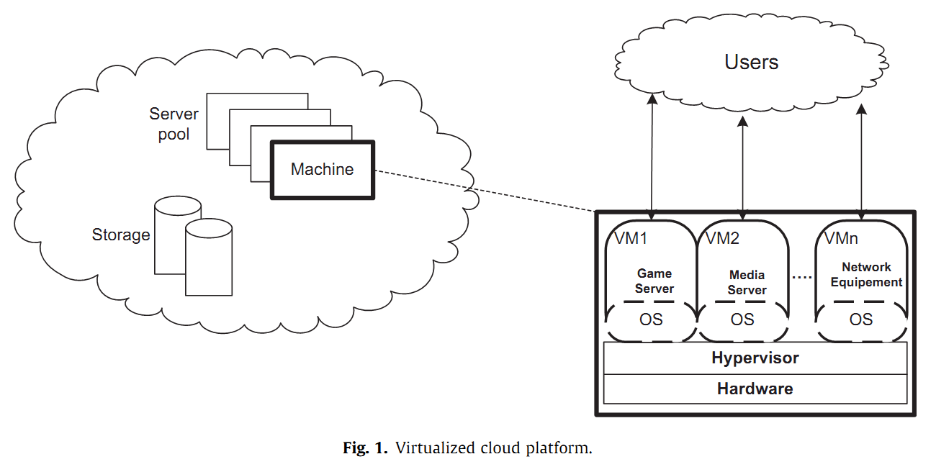
VR of Computing
Partitioning one physical machine
Virtual instances, running concurrently, sharing resources
Key Factor of Virtualization

Slide 16
Hypervisor
Also: Virtual Machine Monitor (VMM)
A software layer presents abstraction of physical resources
Network I/O virtualization is essential
Driver domain based I/O virtualization model
Hosts devices’ physical drivers

Slide 17
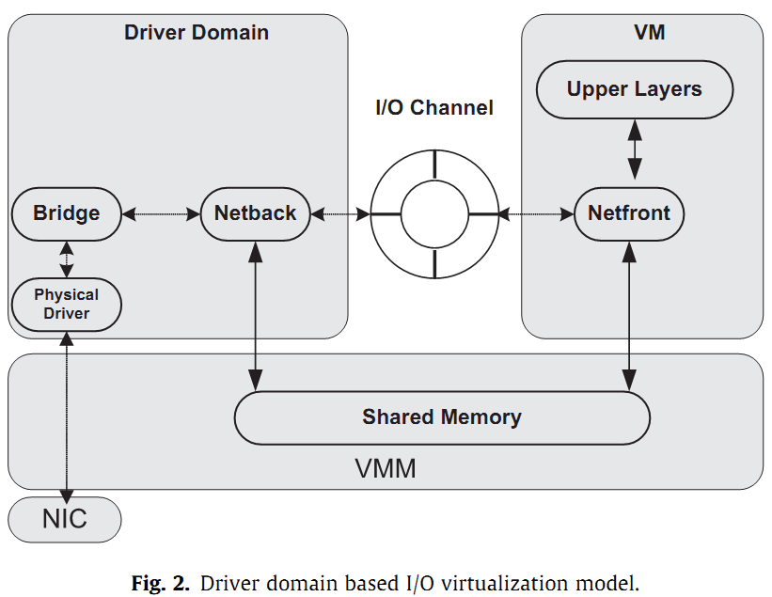
I/O VR Model
Protect I/O access, multiplex / demultiplex traffic, and monitor HW/VM status
Deliver PKTs among VMs in shared memory
Performance bottleneck: Overhead when communicating between driver domain and VMs
Bottleneck

Slide 18
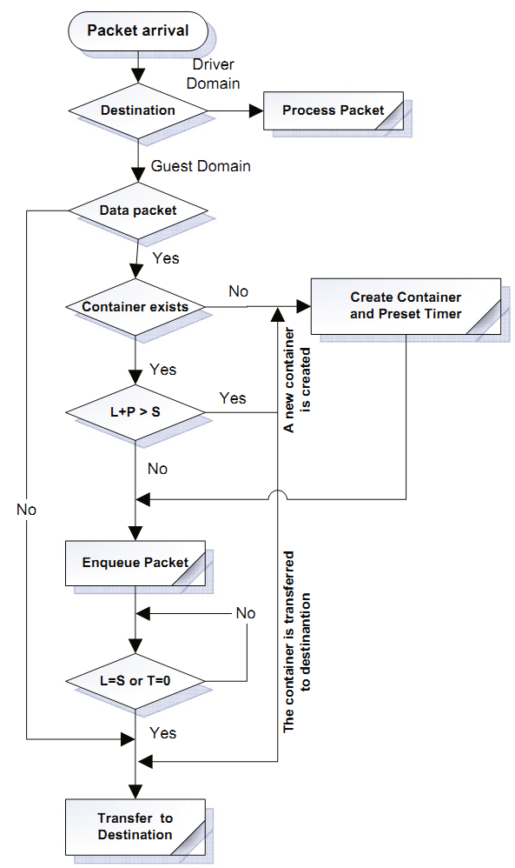
Performance Bottleneck
Overhead when communicating between driver domain and VMs
Mismatch of CPU rounds and memory accessing speed
Sol.: PKT aggregation, container (queue), timeout, and transfer

Slide 19
Hypervisor is the Key
Generalized HW/FW/DR/OS actions
Insert a well-designed VMM in between
Abstraction and automation of phy. resources
These concepts are the same for network virtualization or SDN
OS
OS
OS
Driver
Driver
Driver
Driver
Hypervisor
Firmware
Firmware
Generalized
Interactions
Hardware
Hardware
Firmware
Firmware

Slide 20
Agenda
The Concept of Virtualization
Virtualization of Computing
Virtualization of Networking
Software-Defined Network
Possible Directions
Eric Keller, Jen Roxford, “The ‘Platform as a Service’ Model for Networking”, in WREN, NSDI , Apr. 2010. (Workshop on Research on Enterprise Networking)
Martin Casado, Teemu Koponen, Rajiv Ramanathan, Scott Shenker, “Virtualizing the Network Forwarding Plane”, in PRESTO, ACM CoNEXT, Nov. 2010. (Programmable Routers for Extensible Services of Tomorrow, Conference on emerging Networking Experiments and Technologies)

Slide 21
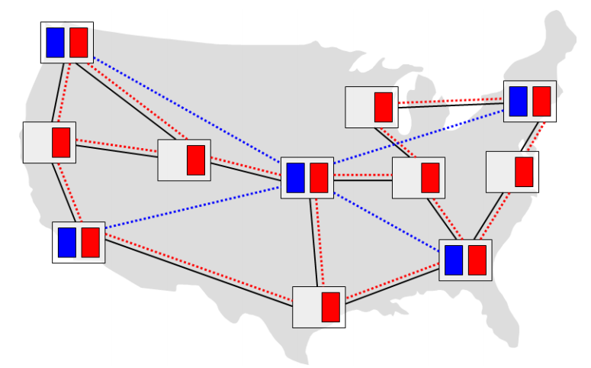
Current Network Virtualization
Virtual Net: A network of vir. routers
Virtual Routers: slice of phy. routers
Connected via partitioned links
Multiple VNs share a phy. substrate
1-to-1 mapping of vir./phy. routers
Topology-dependent: no automation
Manual config., slow adaptation

Slide 22
Disadvantages vs Ideals
Current disadvantages:
User: just as managing a phy. net
Provider: No flexibility, inefficient
Device failure, congestion, topo changes: visible to users and disrupt systems
Ideal:
Independent of topo and app
Substrate = resource pool of networking
Provide in-network functionalities (ACL, Policy Routes, QoS, Tenants)
HW changes: hide from sys. logical view

Slide 23
Decoupled
Platform decoupled from infrastructure
A single router abstraction, for user
Or, a network OS abstraction, for operator
Fully generalized virtualization of forwarding plane
Single phy device shared by multiple vir services
Single logical service ran across multiple phy devices
Automation and dynamic adaptation

Slide 24
Network Hypervisor / OS
Features and descriptions
Network-wide software layer
Under network control applications
On top of distributed networking devices
Multiplex, demultiplex, and monitor
Implemented via distributed system
Distribute network states and loads
Logically centralized (huge difference)
Partitions resources through multiple contexts; Distributes logical context over multiple phy devices. HOW?

Slide 25
Agenda
The Concept of Virtualization
Virtualization of Computing
Virtualization of Networking
Software-Defined Network
Possible Directions
Saurav Das, Yiannis Yiakoumis, Guru Parulkar, Nick McKeown, Preeti Singh, Daniel Getachew, Premal Dinesh Desai, "Application-Aware Aggregation and Traffic Engineering in a Converged Packet-Circuit Network", OFC/NFOEC 2011.
T. Koponen, M. Casado, N. Gude, J. Stribling, L. Poutievski, M. Zhu, R. Ramanathan, Y. Iwata, H. Inoue, T. Hama, and S. Shenker. “Onix: A Distributed Control Platform for Large-scale Production Networks.” In Proc. OSDI , October 2010.

Slide 26
OpenFlow/Software-Defined Network(SDN)
3. Well-defined open API
2. At least one Network OS probably many. Open- and closed-source
Routing
Traffic Engineering
Network OS
1. Open vendor agnostic protocol
OpenFlow
Simple Packet
Forwarding
Hardware
Simple Packet
Forwarding
Hardware
Simple Packet
Forwarding
Hardware
Simple Packet
Forwarding
Hardware
Simple Packet
Forwarding
Hardware

Slide 27
Provide Choices
Bandwidth - on - Demand
Dynamic
Optical
Bypass
Unified Recovery
Application-Aware QoS
Traffic Engineering
Networking
Applications
NETWORK OPERATING SYSTEM
Unified
Control
Plane
VIRTUALIZATION (SLICING) PLANE
OpenFlow Protocol
Switch Abstraction
Packet & Circuit Switch
Packet & Circuit Switch
Underlying Data
Plane Switching
Packet Switch
Wavelength Switch
Multi-layer
Switch
Time-slot
Switch
Packet Switch

Slide 28

Architecture
Control Plane / Applications
API
Logical Forwarding Plane
Provides
Abstraction
Control Commands
Logical States Abstractions
Provides
Network Hypervisor
Onix / Network OS
Mapping
Network Info Base
Distributed System
Distributes, Configures
Real States
OpenFlow

Slide 29
Switch Forwarding Pipeline
Logical Forwarding Plane
As pkts/flows traverse the network: moving both in logical and physical forwarding plane → logical context

Slide 30
Switch Forwarding Pipeline
Configures
by hypervisor
States distributed to local switches
Logical Context
Logical Forwarding Decision
Pkt inbound
Pkt outbound
Mapping to logical context
Mapping decision to physical
Physical Forwarding

Slide 31
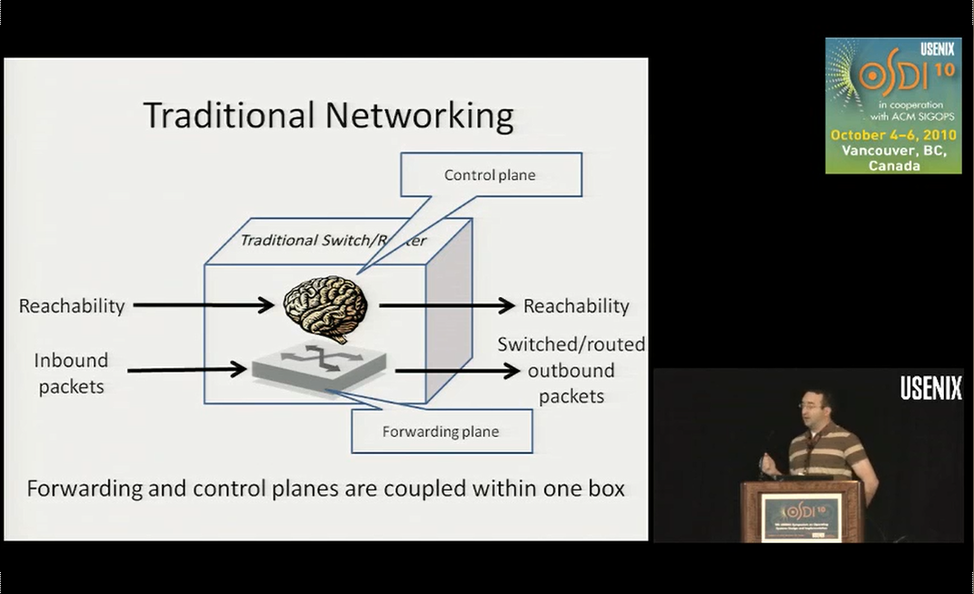
Onix: Distributed Control System

Slide 32
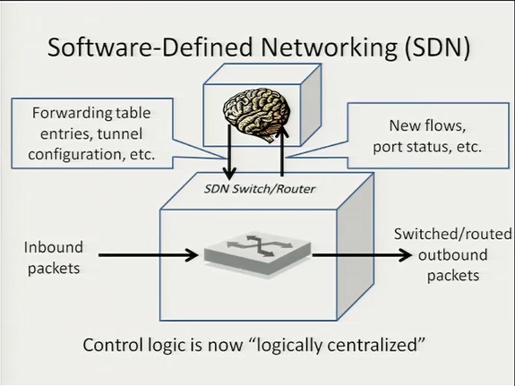
Distribute states by network os/hypervisor
Report events by switches
No dist. algo. How to scale?

Slide 33
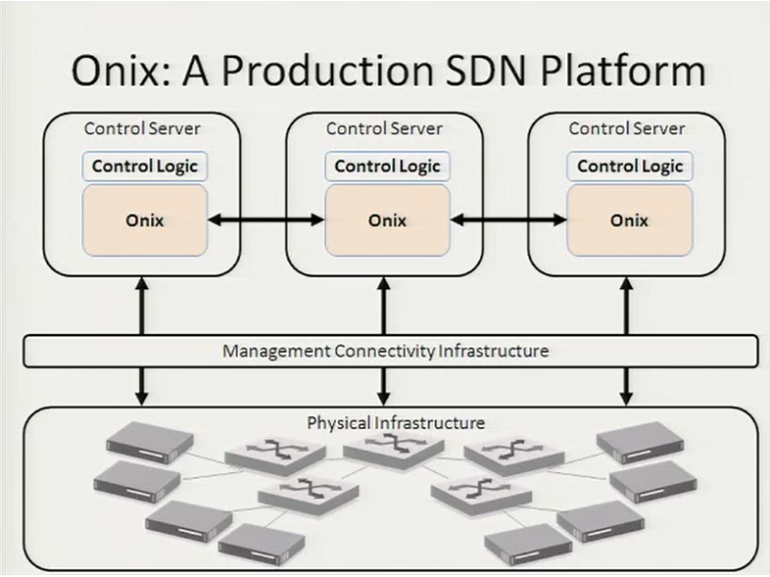
Turn into dist. sys.
Notes:
Software and libraries

Slide 34
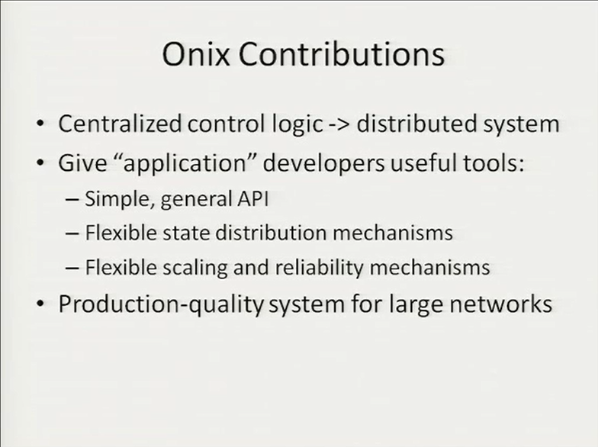
Libraries and APIs
Tradeoffs taken by designers
Abandoned unified and consistent states
Another jump from NOX controller
Prototype→Product

Slide 35
Platform Design

Slide 36
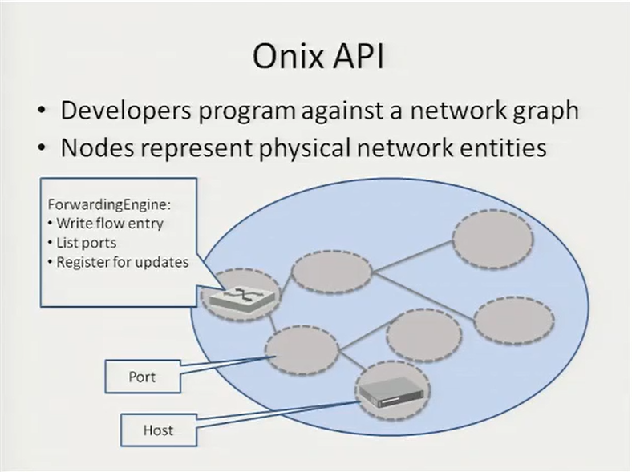
The simplest and most general
Or logical entities
Objects, may call methods upon these objects

Slide 37
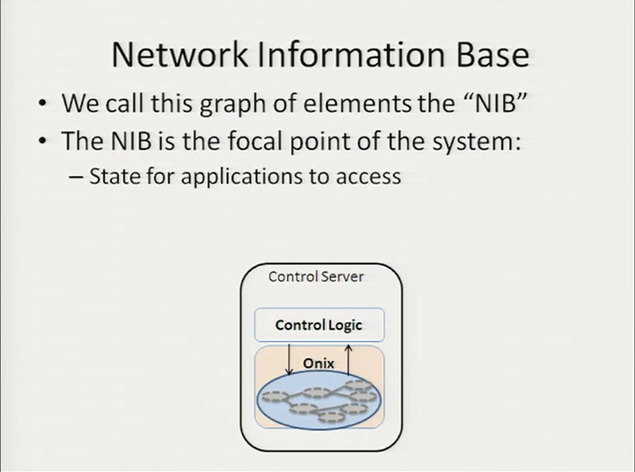
c.f. FIB or RIB, but for entire network
Manipulated
Get notified

Slide 38
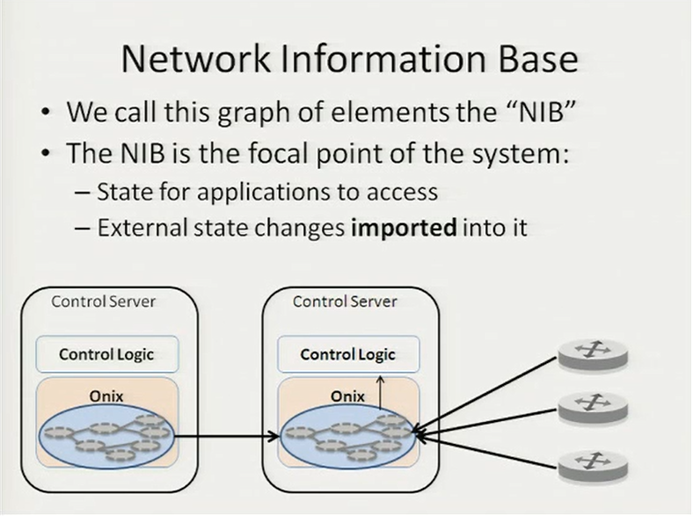
Then notify control APPs
Reporting
Talking

Slide 39
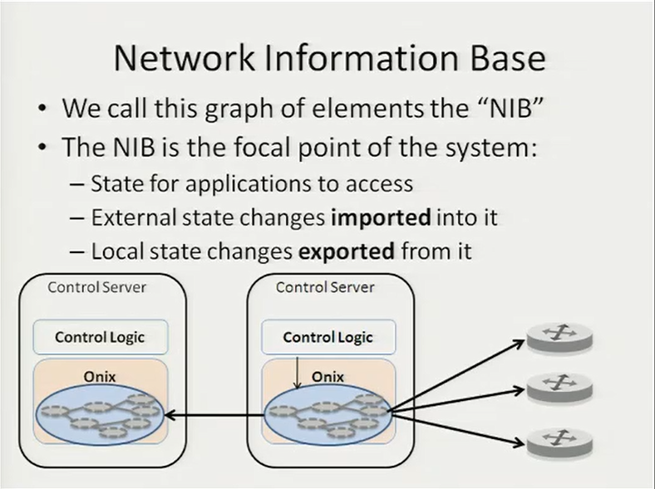
Figures proper mapping and distributes
Updating

Slide 40
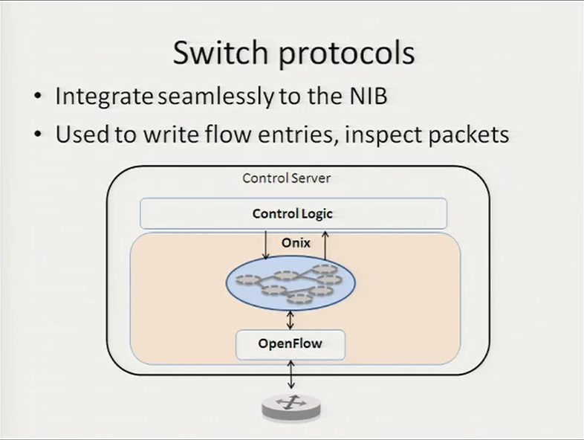
Talks only to the NIB
Inport/export module
Translate into actions

Slide 41
Data Distribution Design

Slide 42
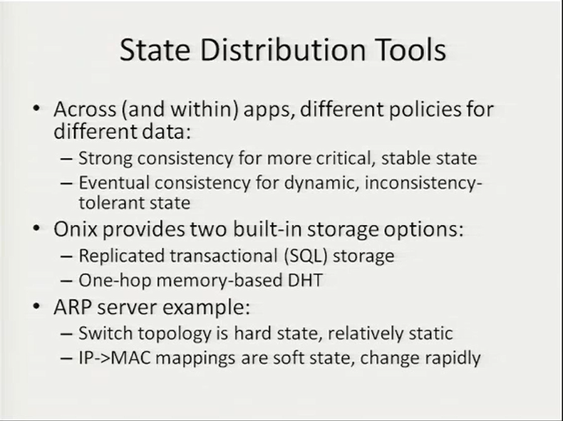
NIB may be HUGE….so…
Distribute to other Onix instances/servers and also switches
According to different tradeoffs
For strong consistency
For flexibility and performance
Can be relearned, conflicts can be solved

Slide 43
What’s DHT?
Computer Networking Ch 2.6.2
Distributed database (among peers) for indexing and searching simple (key, value) pairs
Key controls which peer stores the value, and the peer is responsible for a section of the space
Self-organizing, automatically distributes load across peers and sends queries to a limited number of peers

Slide 44
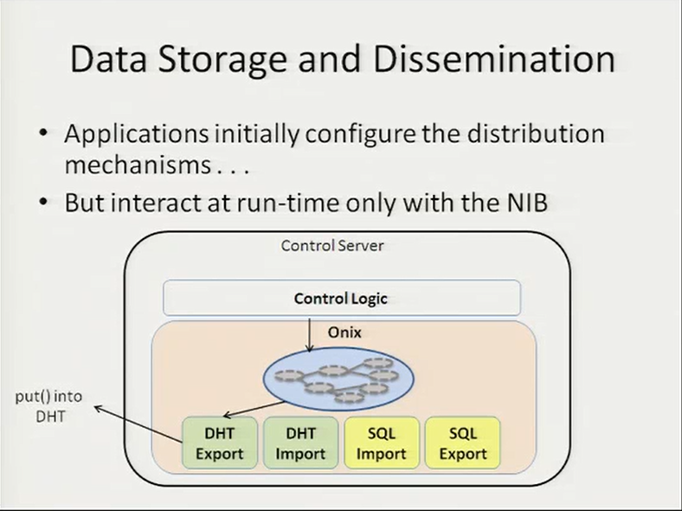
Inspect predefined configurations
Follow initialization, load default actions
Design between spectrum of consistency and flexibility
Make changes to NIB objects by respective methods.

Slide 45
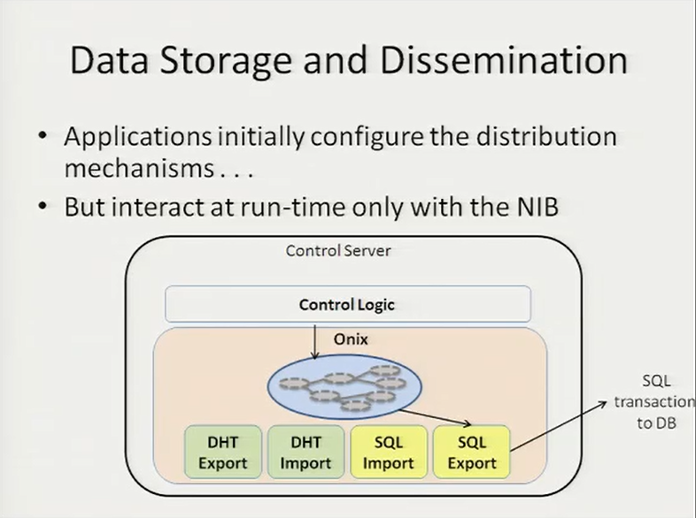

Slide 46
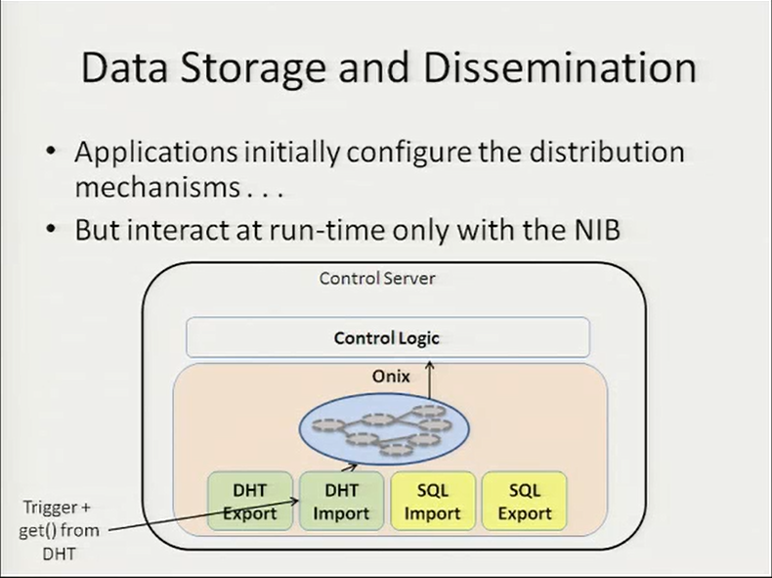
Modify NIB

Slide 47
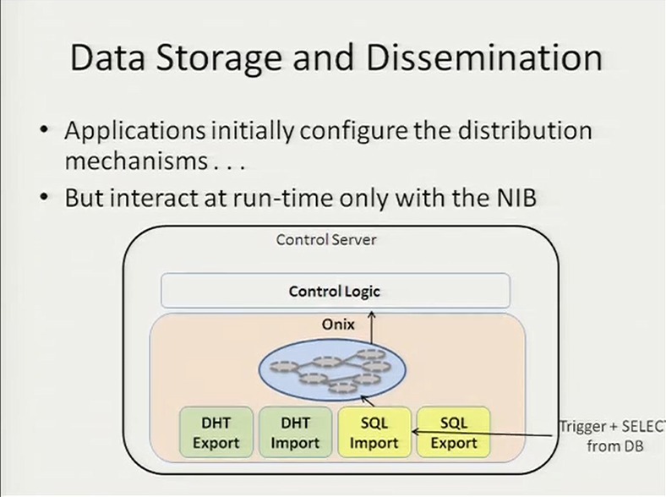

Slide 48
Scaling and Reliability

Slide 49
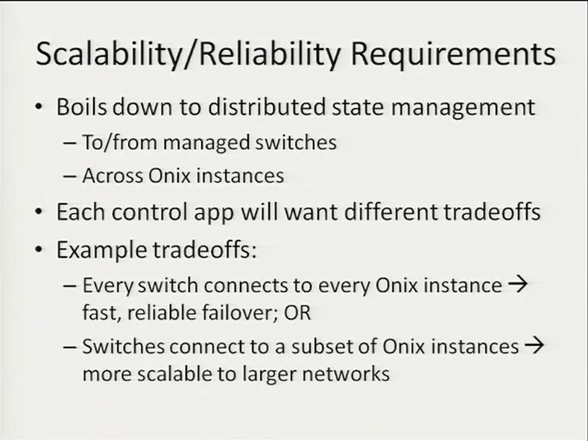
, and across switches
May be fast but not scalable

Slide 50
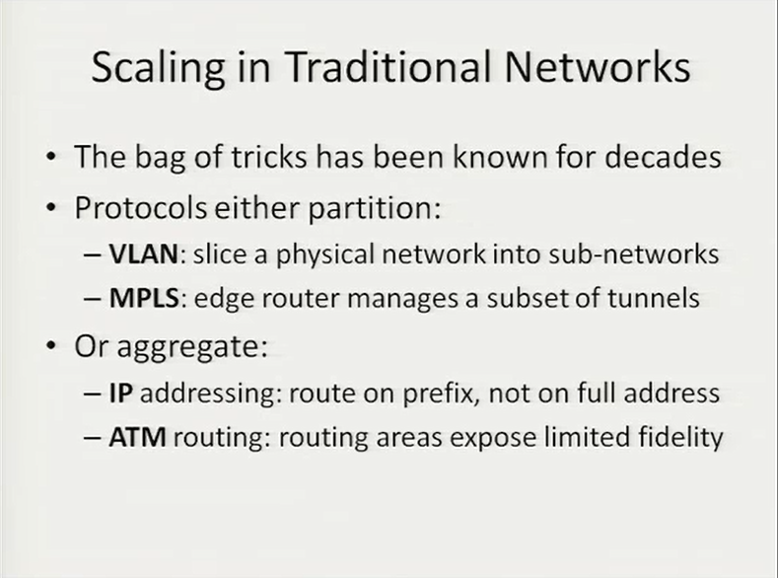
Reduce fidelity, easier to send across the network
These techniques are all provided. Developers may choose.

Slide 51
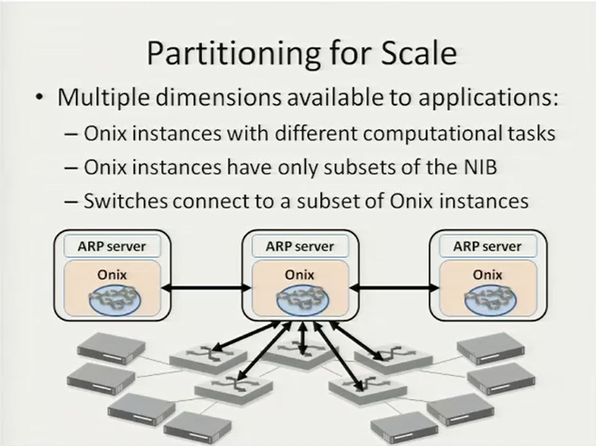
Coordinate through Zookeeper
(DHT)

Slide 52
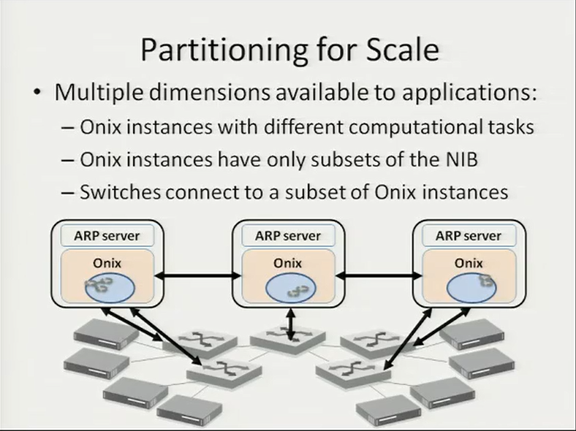

Slide 53
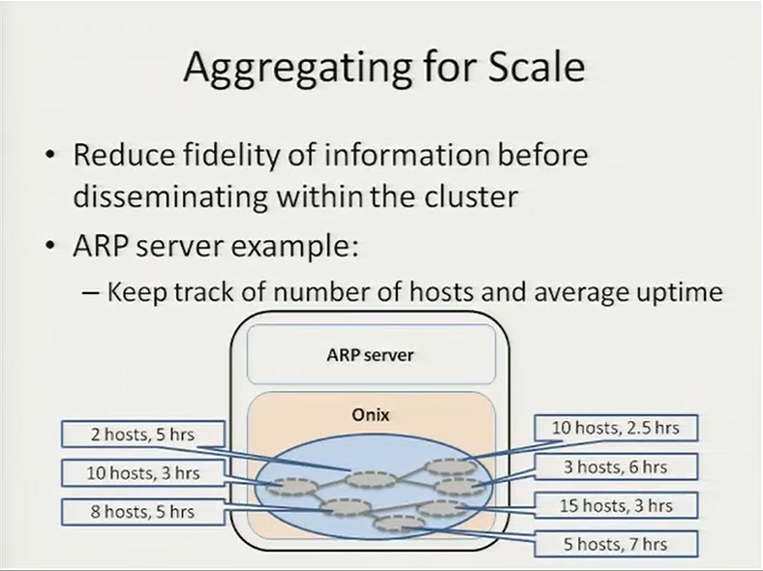
Share with other Onix instances
Changing rapidly. Could be too much info. Remote Onix may NOT check this frequently

Slide 54
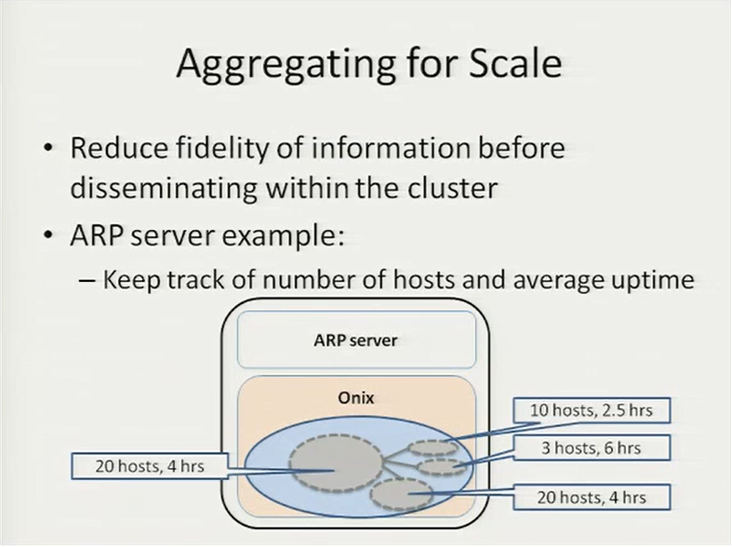
Send reduced version to other Onix instances. Some picture but not complete

Slide 55
Implementation and Use Cases

Slide 56
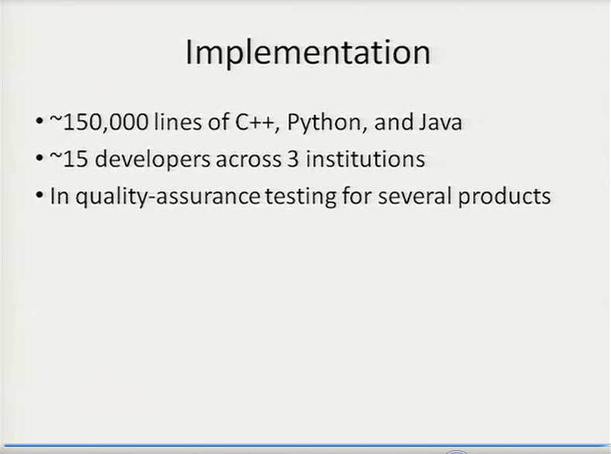
c.f. NOX: 32,000 lines.
Nicira, Google, NEC

Slide 57
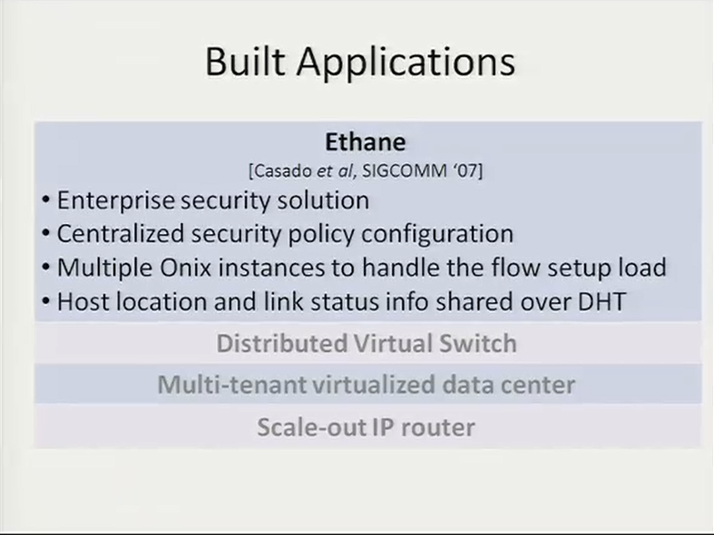
Per-flow policy
Various security properties
Performance pressure
Distributed, DHT

Slide 58
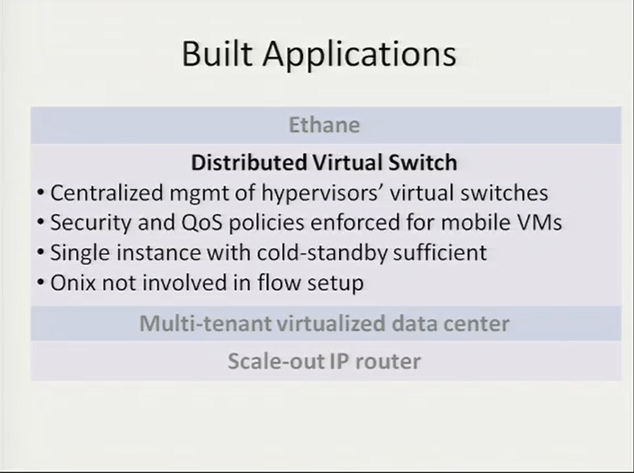
Same policy for a VM, wherever it goes.
States, policies, current connections stored in vSwitches, but also a backup in Onix.
Keep track, enable mobility, and backup

Slide 59
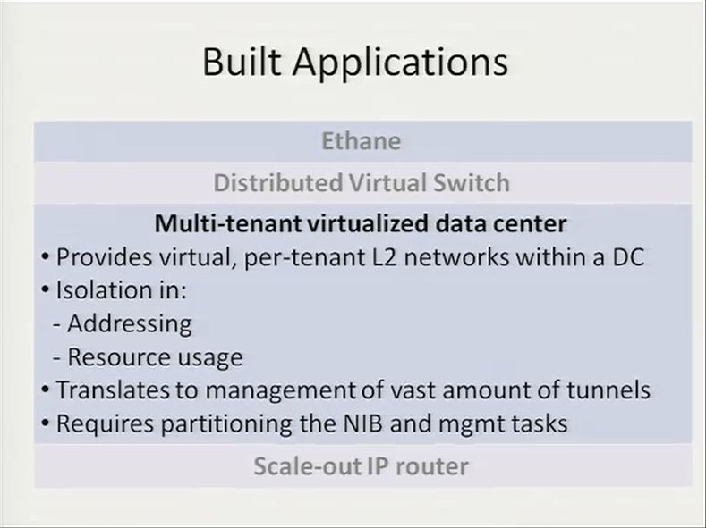
For each tenant
VL2 / PortLand

Slide 60
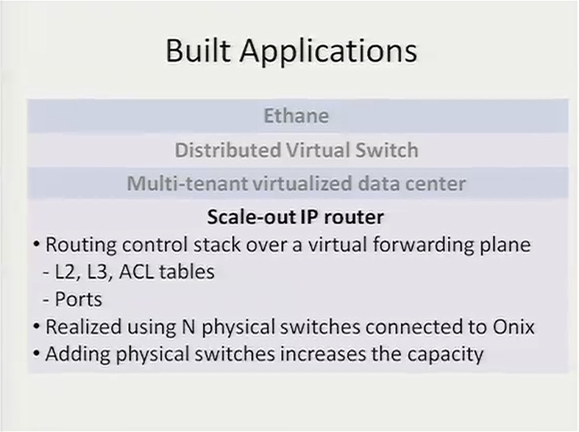

Slide 61
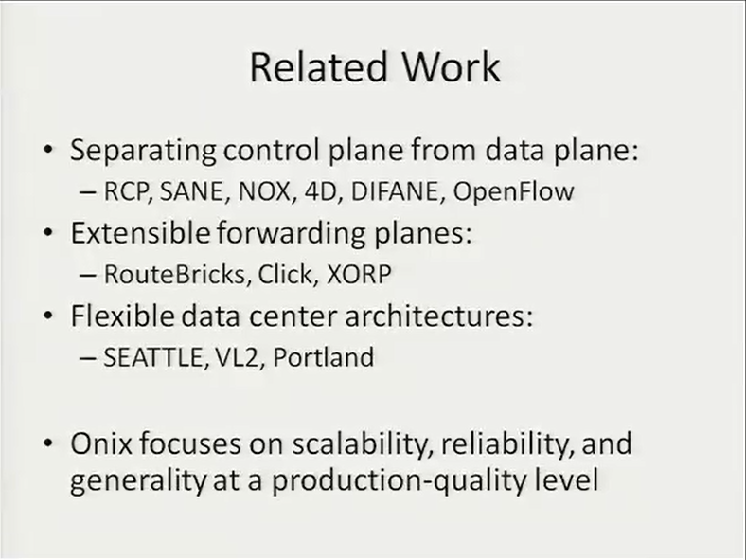
Already 5~7 years.
Turning into dist. sys. and provide a general platform/tool for developers.

Slide 62
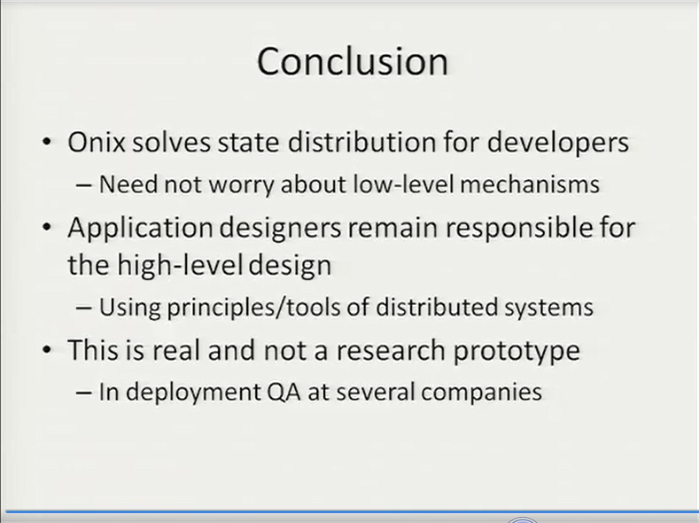
And distributed management.
Rather than low level dist. algo.
Zookeeper: Coordination
DHT: Real-time multi-access
SQL: Consistent storage
Aggregation / Partitioning
A combination of existing techniques
New architecture and interactions, NIB.

Slide 63
Agenda
The Concept of Virtualization
Virtualization of Computing
Virtualization of Networking
Software-Defined Network
Possible Directions

Slide 64
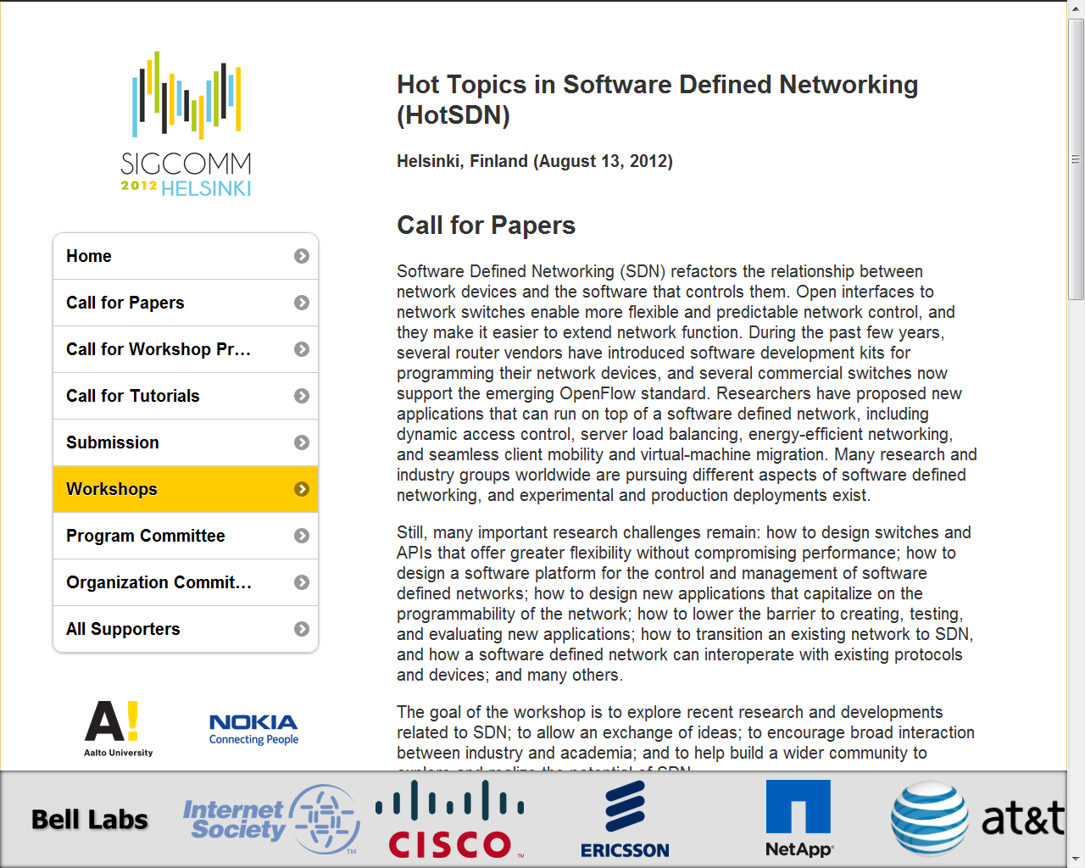

Slide 65
Possible Research Issues
Protocols/func.s based on abstraction of complete net graph/status
New applications capitalizing on the programmability of the network →ex: programmable BS/AP in wireless?
SDN interoperating with legacy protocols or different network types
Harder and requires bigger scale:
Virtualization support in software-defined networks
Control and mgmt software/platform stack for SDN

Slide 66
Possible Research Issues
Assume logical network graph available
Not low-level distributed algorithm →Logically centralized algorithm →Higher level abstraction and action
Engineering specifications and issues:
Consistency requirement
Time scale and responsiveness
Targeted “objects”, ex: tunnels or flows?
Relate “logical context” and actions
Faster cycles: sim.s to impl’m’ts

Slide 67
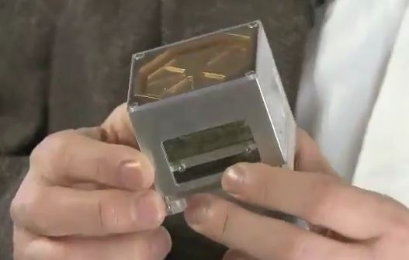

Apply to Wireless
Alcatel-Lucent LightRadioTM
Dist. BS, break into components
Wideband Active Array Antenna
Multiband Remote Radio Head
Baseband Unit
Controller and common management solution
Virtualized wireless controllers and gateways, coordinate all above →Programmable gate arrays
Multi-mode: 2G, 3G, LTE, and WiFi
Switching between, without dropping customers from connection, small cell

Slide 68
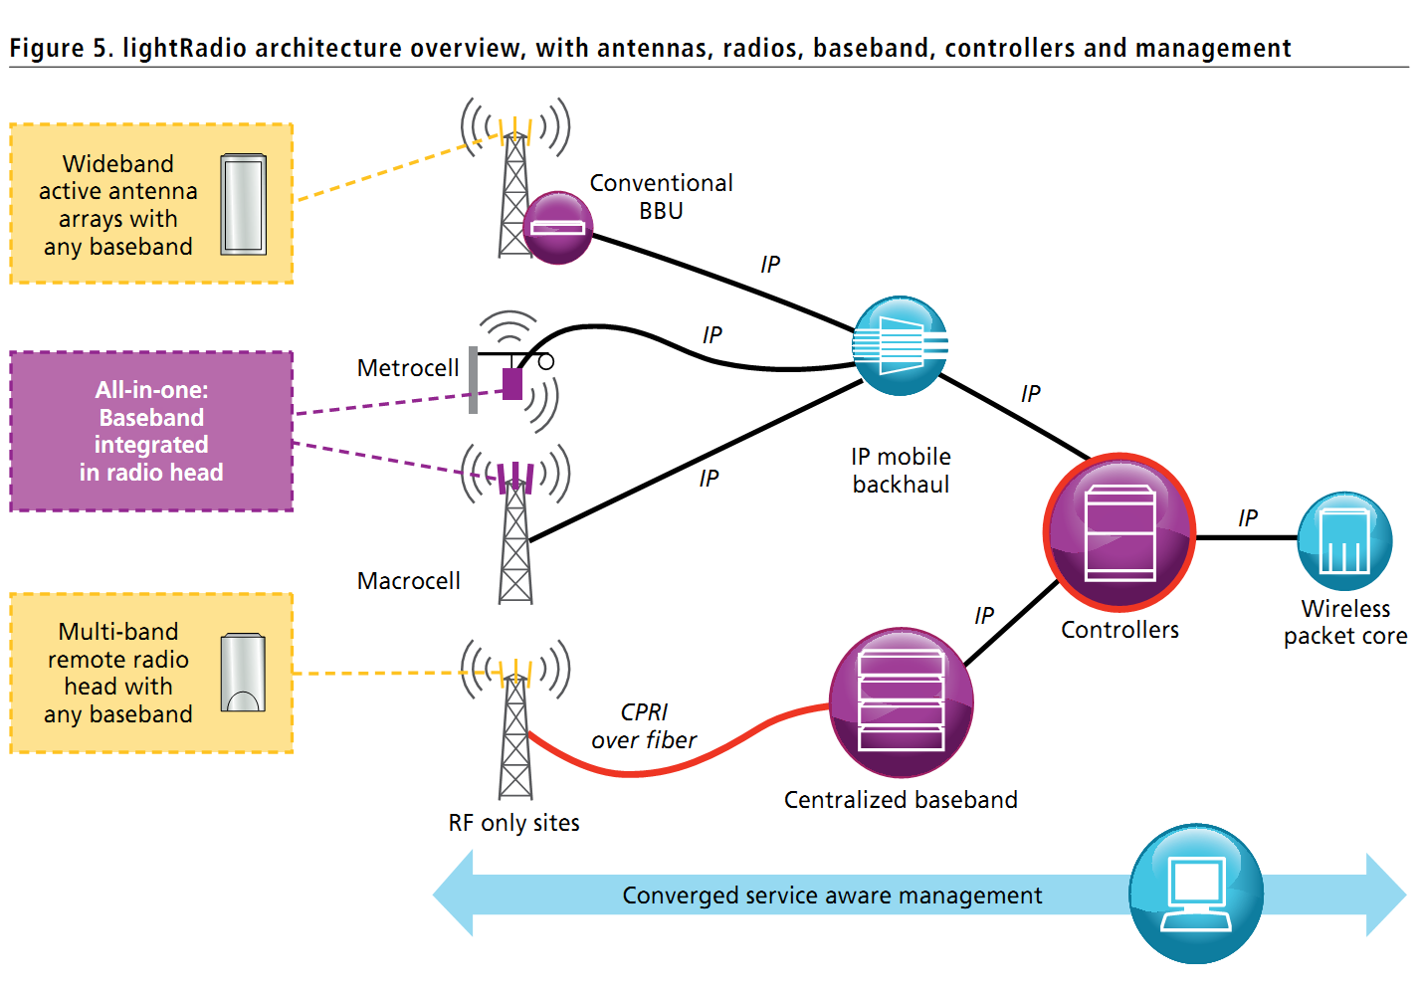
CPRI: standard interface of BS between REC and RE
(Radio Equipment Controllers)

Slide 69
Reference
Research Publications
Manel Bourguiba, Kamel Haddadou, Guy Pujolle, “Packet aggregation based network i/o virtualization for cloud computing”, Computer Communication 35, 2012
Eric Keller, Jen Roxford, “The ‘Platform as a Service’ Model for Networking”, in Proc. INM WREN , 2010
Martin Casado, Teemu Koponen, Rajiv Ramanathan, Scott Shenker, “Virtualizing the Network Forwarding Plane”, in Proc. PRESTO (November 2010)
Teemu Koponen et al., “Onix: A distributed control platform for large-scale production networks”, OSDI, Oct, 2010
Saurav Das, Yiannis Yiakoumis, Guru Parulkar, Nick McKeown, Preeti Singh, Daniel Getachew, Premal Dinesh Desai, "Application-Aware Aggregation and Traffic Engineering in a Converged Packet-Circuit Network", OFC/NFOEC 2011.
Technology News, Blogs, or Forums
Tom Simonite, “A New Net”, Technology Review, March/April magazine feature story, 2012
Kate Greene, “TR10: Software-Defined Networking”, Technology Review, March/April 10 Emerging Technologies, 2009
Tom Nolle , “OpenFlow concept embodies challenges to Cisco’s resurgence”, May 2011, IT Knowledge Exchange

Slide 70
Reference
Alcatel-Lucent LightRadioTM
Steve Kemp, Tom Gruba, “lightRadio™ Technology Overview”, TechZine Home, Alcatel-Lucent.
J Gozalvez, “Heterogeneous Wireless Networks [Mobile Radio]”, Vehicular Technology Magazine, IEEE, 2011
CAROLINE GABRIEL, “Alcatel-Lucent calls death of the base station”, Rethink Wireless, 2011, Rethink Markets LTD.
Videos and Open Networking Foundation
Open Networking Summit, 2011
Martin Casado, "Origins and Evolution of OpenFlow/SDN", Nicira Networks PDF Slides: http://opennetsummit.org/talks/casado-tue.pdf
Scott Shenker, "The Future of Networking, and the Past of Protocols", ICSI/Berkeley/ONF PDF Slides: http://opennetsummit.org/talks/shenker-tue.pdf
Nick McKeown, "How SDN will Shape Networking", Stanford/ONF PDF Slides: http://opennetsummit.org/talks/mckeown-tue.pdf
Open Networking Foundation
Teemu Koponen et al., “Onix: A distributed control platform for large-scale production networks”, OSDI, Oct, 2010

Slide 71
